Slide 1

Fault Impact Analysis: Towards Service-Oriented Network Operation AND Maintenance by ITU

Slide 2
Fault impact analysis in RAN is challenging due to:
Stochastic nature of RAN KPIs
Complexity of RAN networking
Uncertainty due to customer segmentations and non-RAN faults

Slide 3
Machine learning can be used to solve these challenges by developing a gradient boosting tree model that can predict the impact of faults on RAN KPIs with high accuracy. This model can be used to:
Prioritize faults
Allocate O&M resources more effectively
Improve the reliability and resilience of networks and services

Slide 4
02
Proposed solution

Slide 5

PROJECT ARCHITECTURE
Data cleaning
Feature engineering
Feature selection
Model selection
Modeling
Testing

Slide 6
Machine learning models need clean input data to give better results.
Data cleaning
The dataset contained different corrupt data points:
52 records had no non-faulty data point and were dropped.
Some rows contained relation values less than 0 and were replaced with 0.
Some rows had more than a one hour gap between before and after the fault occurred, but were not dropped due to the short time to experiment with their effect.

Slide 7
Feature engineering
endTime | data rate | diff | diff1
2/20/2023 8:00 | 38.5 | nan
2/20/2023 9:00 | 24.5 | 24.5- 38.5 | -14
2/20/2023 10:00 | 21.8 | 21.8 - 24.5 | -2.7
2/20/2023 11:00 | 23.2 | 23.2 - 21.8 | 1.4
Difference and ratio change of KPI features:
Calculated the difference one, difference two, and difference three of the RAN KPIs features.

Slide 8
Feature engineering
Difference and ratio change of KPI features:
This helps the model learn more about the data, as it can distinguish the change of KPIs features.
Other KPI features were also computed as the difference one, two, and three.

Slide 9
Feature engineering
Binarization of difference::
If the difference value is greater than 0, the label is set to 1, otherwise 0.
This avoids outliers and gives the probability of increasing or decreasing.
For example, if the last three hour data rate values are [-3, 40, -10] and [-1, 1, 3], the mean value of the first is 9 and the second is 1.

Slide 10
Feature engineering
Binarization of difference::
This would indicate a more positive value for the first one, but the first one has decreased in the last hour, while the second one is increasing slightly.
When the model gets this mean value, it will give a higher probability for the second one to decrease in the next hour.
Binarizing the difference prevents outlier impacts on the model's performance.

Slide 11
Feature engineering
Ratio of KPI values:
Computing the ratio of KPI values gives the model more information about the data change weight.
endTime | data rate | Ratio change | Ratio one
2/20/2023 8:00 | 38.5
2/20/2023 9:00 | 24.5 | 24.5 / 38.5 | 0.64
2/20/2023 10:00 | 21.8 | 21.8 / 24.5 | 0.89
2/20/2023 11:00 | 23.2 | 23.2 / 21.8 | 1.06

Slide 12
Feature engineering
Ratio of KPI values:
[2.3, 4.6] and [120, 130]
Computing the difference gives the second value a more positive value, but the increase from 120 to 130 is not so high ratio.

Slide 13
Feature engineering
Ratio of KPI values:
However, computing the ratio shows that the first value is increasing double (from 2.3 to 4.6).
This information is more useful for the model, as it can understand how much weight the data value has increased.
This also helps to prevent model overfitting, as the model will be able to generalize to new data more effectively.
The ratios 2 and 3 were also computed.

Slide 14
Feature engineering
Lag and rolling features:
24 lag features: This captures the previous 24 hour values of the data rate.
5 rolling mean, max, and min KPI features: This captures the mean, max, and min values of the data rate over the previous 5 hours.
These features help the model to learn about the previous time patterns of the data rate, which can be useful for predicting future values.

Slide 15
Feature engineering
Binning numerical columns:
Faulty duration column: binned into 10 categories, with each category representing 6 minutes.
Relation column: binned into 10 categories, with each category representing 0.1 of the range.

Slide 16
Feature engineering
Combining two or more columns:
Hour, week of day, and binned faulty duration column combined into one column.

Slide 17
Feature engineering
Binary of diff1, diff2, and diff3::
Difference between consecutive values of numerical columns is converted to binary (1 if positive, 0 if negative).
Binary values for diff1, diff2, and diff3 are summed and combined with other columns.
More than 20 columns were created using these methods.

Slide 18
Feature engineering
More than 20 columns were created using these methods.
Note: The last method is particularly interesting because it captures the direction of change in numerical columns, which can be useful for machine learning models.

Slide 19
Feature engineering
Mean encoding:
For example, if we have a feature called "hour" and the target variable is "data rate", we can use mean encoding to replace each hour with the mean data rate for that hour.
This would give the model a better understanding of the relationship between hour and data rate.

Slide 20
Feature engineering
Mean encoding:
In the experiment, the most important features were grouping by NE ID and hour, then computing the mean, max, and min.

Slide 21
Feature engineering
Target encoding:
In the project only used target encoding in a few columns, like hour and day.

Slide 22
Feature engineering
Automatic feature engineering function:
Takes two arguments: df (dataframe) and cols (list of columns)
Iterates over cols and adds, subtracts, multiplies, and divides each column from the rest of the RAN KPI features
Creates new features based on these operations
This function can save time and create unexpected features, which can improve the performance of machine learning models.

Slide 23
Feature selection
Effective way to reduce high dimensionality to low dimensionality.
Prevents machine learning models from overfitting on redundant features.
Improves the accuracy and stability of the model.
LightGBM feature importance was used for feature selection in this experiment.

Slide 24
Validation strategy
Stratified 10-fold cross-validation was used to evaluate the model, as the target class is slightly imbalanced and the metric is F1 score.
Stratified K-fold cross-validation ensures that the proportion of positive to negative examples found in the original distribution is respected in all the folds. This is important for imbalanced datasets, as it helps to prevent the model from overfitting the majority class.

Slide 25
Model Selection
Different models perform better on different types of data.
Artificial neural networks (ANNs) are well-suited for unstructured data, while boosting tree models are still the best performers on tabular data.
In this experiment, tree-based models such as LightGBM and CatBoost were used due to the nature of the dataset.

Slide 26
03
Results

Slide 27
models results
model name | n_feature | f1 score
 |  | local | private
lightgbm | 500 | 75.7 | 74.53
lightgbm | 300 | 75.8 | 74.44
catboost | 500 | 75 | 75.0
stack of three |  | 75.5 | .74.95

Slide 28
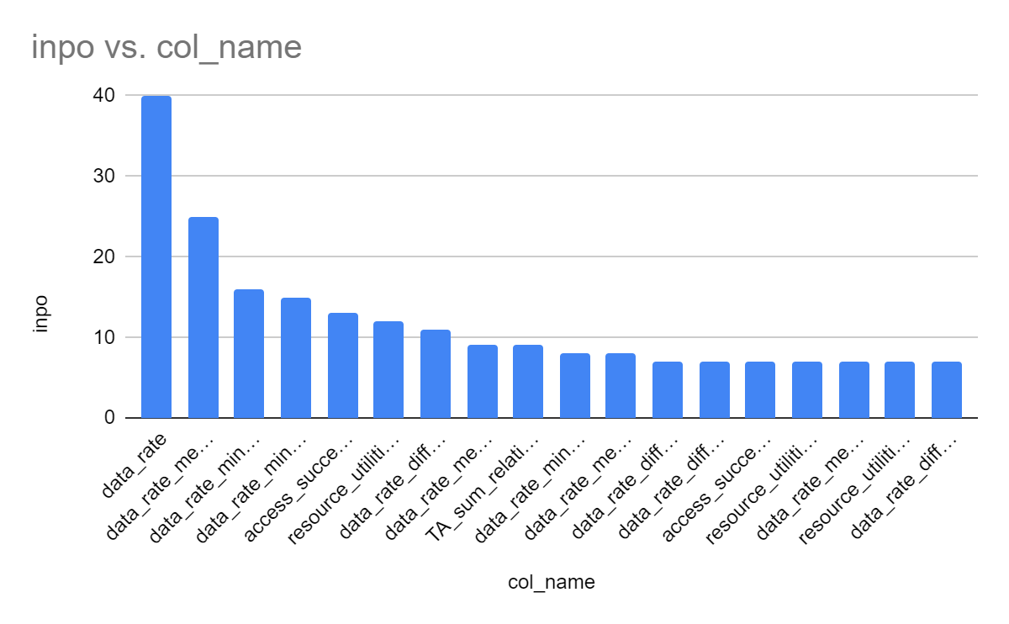
features importance
inpo | col_name
40 | data_rate
25 | data_rate_mean_NE IDhour__mean_en_all_rows
16 | data_rate_min_NE IDhour__mean_en_all_rows
15 | data_rate_min_relation_fault_weekday__mean_target_en_all_rows_label1
13 | access_success_rate_size_relation_fault_weekday__mean_target_en_all_rows_label1
12 | resource_utilition_rate_diff1_mean_NE IDhour__mean_en_all_rows
11 | data_rate_diff1_sum_id__mean_en_all_rows
9 | data_rate_mean_NE IDdaydayofweekhour_train_mean_en_top_cols
9 | TA_sum_relation_fault_weekday__mean_target_en_all_rows_label0
8 | data_rate_min_relation_fault_weekday__mean_target_en_all_rows_label0
8 | data_rate_mean_NE IDdayofweekhour_train_mean_en_top_cols

Slide 29
04
Discusion

Slide 30
The stacked the predictions of LightGBM and CatBoost models, using 500 features, achieved an F1 score of 74.95.
My results suggest that machine learning can be used to effectively predict the impact of faults on RAN KPIs. This can help network operators to identify and resolve faults more quickly and efficiently.
However, there are a few limitations to my project. First, I only used a simple feature selection method. Second, I did not tune the model. Third, I did not use deep learning models such as LSTM.

Slide 31
In future work, I plan to address these limitations by:
Using effective feature enginerring methods
Using different feature selection methods
Using deep learning models such as LSTM
We believe that these improvements will further improve the accuracy and effectiveness of our models.

Slide 32
05
Conclusion

Slide 33
Conclusion
Machine learning methods showed better results.
The gradient boosting method achieved a better score than another machine learning model.

Slide 34
Conclusion
The LightGBM and Catboost models achieved a 74.95 F1 score on 500 and 300 selected features, respectively.
I was able to achieve this result with less than 500 features and 7222 samples, but I believe that adding new features and removing some multicolinear features would improve the results even further.
Gradient boosting is a promising machine learning method for analyzing the impact of faulty RAN KPIs.

